Slide 1
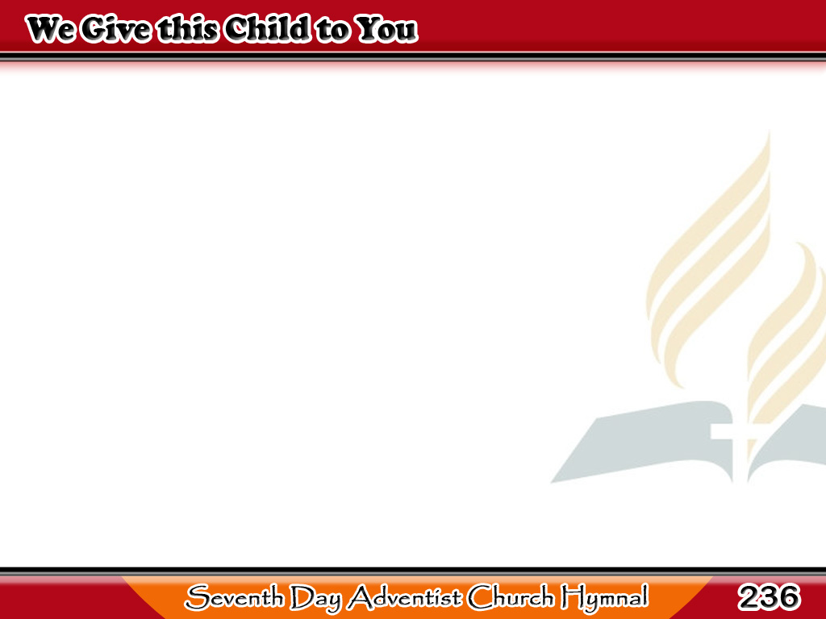
Bata’y Aming Alay
We give this child to You,
Our precious gift of love.
Help us to lead each step aright
With guidance from above.
1/3

Slide 2
Bata’y Aming Alay
O bless each child of Yours,
And grant when they are grown,
They will have learned
to love Your way,
And choose it for their own.
2/3

Slide 3
Bata’y Aming Alay
We give ourselves to You,
And may Your Spirit fill
Our hearts and home,
that all we do
Be subject to Your will.
3/3

